Slide 1
Minimizing Power Consumption of MIMO Network Using a Novel Unconstrained Quantum Genetic Algorithm
Areeba Tabassum Shoaib
Advisor : Sara-El-Gaily (Ph.D.)
Notes:
Good afternoon, ladies and gentlemen. Today, I am excited to present to you my research on minimizing power consumption in MIMO networks using a novel Unconstrained Quantum Genetic Algorithm.

Slide 2

Contents
01
Motivation
02
Algorithms
03
MIMO Model
04
Implementation & Configuration
05
Results
06
Computational Complexity
07
Conclusion & Future Work
Notes:
These are the topics that we’ll discuss

Slide 3
1
Motivation

Slide 4


MOTIVATION
Power Drain: Unleashing the Energy Monster in MIMO Networks
High power consumption.
MIMO networks' energy usage challenges sustainability and cost effectiveness
Power drain hampers eco-friendly wireless systems.
Unlocking Energy Efficiency in MIMO Networks
Quantum computing advancements provide new possibilities for solving previously intractable optimization problems.
Implementing the developed Unconstrained Quantum Genetic Algorithm can lead to reduced power consumption, improved network performance, and cost savings.
Notes:
This research aims to develop an Unconstrained Quantum Genetic Algorithm that combines quantum computing and genetic algorithms to optimize power consumption, in MIMO networks.

Slide 5
2
Algorithms

Slide 6
UCGA
QBC
QEVSA
The Unconstrained Classical Genetic Algorithm is an evolved variant of GA for optimization without constraints. It iteratively improves a population of potential solutions through selection, crossover, and mutation, mimicking biological evolution.
The Quantum Blind Computing ensures secure computation where quantum nodes cannot access or disclose data, preserving privacy and confidentiality. Ongoing research explores its various applications and implementation methodologies.
The Quantum Extreme Value Searching Algorithm integrates logarithmic search and Quantum Existing Testing (QET) to efficiently find extrema in objective functions, enhancing optimization effectiveness. QET handles unsorted databases, providing definitive "Yes" or "No" answers, contributing to QEVSA's effectiveness in optimization problem-solving. Make this smaller
1
2
3
UQGA
Notes:
Before we dive into the details of the developed Unconstrained Quantum Genetic Algorithm (UQGA), We will briefly explore the key algorithms that form the basis of our research
The Unconstrained Classical Genetic Algorithm (UCGA) is an evolutionary optimization method that employs selection, crossover, and mutation to improve solutions.
Quantum Blind Computing (QBC) ensures privacy and confidentiality during computation, allowing clients to utilize external quantum nodes while protecting sensitive data.
The Quantum Extreme Value Searching Algorithm (QEVSA) combines binary search with Quantum Existing Testing (QET) to efficiently locate the maximum or minimum value of an objective function, enhancing the algorithm's optimization capabilities.

Slide 7
Unconstrained Quantum GENETIC ALGORITHM
Generate Regions
Select first half of the population denoted as parents
Mutation
Is Optimum solution found?
YES
8
Apply QEVSA in each region to generate initial population
Crossover
New Population
Stop
Notes:
1 Start with 𝑠𝑡𝑒𝑝 = 0. Set the size of the database 𝑁, initial population 𝑆, size of the region 𝑅.
2 Generate the 𝑆 regions.
3 Apply the QEVSA in each region in order to generate the initial population.
4 Select the first half of the population (parent set) by applying the QEVSA 𝑆/2 times.
5 Apply the crossover and mutation to the parent set in order to generate the offspring set.
6 Unify the parent and offspring sets to produce the new population 𝑃𝑠𝑡𝑒𝑝+1.
7 If the optimum solution 𝐹𝑜𝑝𝑡 is found, then stop, else go to 3.

Slide 8
3
MIMO Model

Slide 9
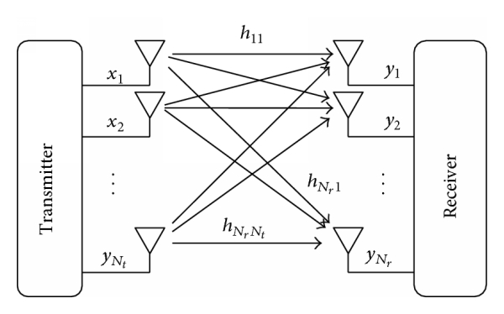
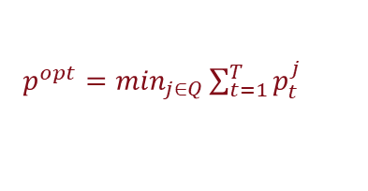
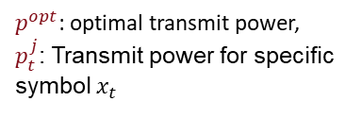
Mimo model
1
Model
This model has a single base station with T transmit antennas. On both the receiver and transmitter sides, it is assumed that full knowledge of channel status information exists.
2
$p^{opt}=\min_{j∈Q}\sum_{t=1}^{T}{p_{t}^{j}}$
$p^{opt}$: optimal transmit power,
$p_{t}^{j}$: Transmit power for specific symbol $x_{t}$
Notes:
The MIMO system consists of a single base station outfitted with T transmit antennas. In this scenario, there is only one user who possesses R receive antennas. Our objective is to mathematically formulate an optimization problem to determine the optimal transmit power.

Slide 10
4
Implementation
&
Configuration

Slide 11




IMPLEMENTATION & CONFIGURATION
UQGA
QMSA
QEVSA
Unconstrained Quantum Genetic Algorithm
Quantum Minimum Searching Algorithm
Quantum Extreme Value Searching Algorithm
$$G=\frac{P_{max}−P_{min}}{α}$$
Notes:
We implemented uqga as a qmsa, where we configured QEVSA, which is the core of this algorithm as minimum searching algorithm, and it is important to mention that to run this qevsa, it is very important to carefully configure the value of maximum number of steps needed to run the logarithmic algorithm which depend on the variation of the maximum and minimum distance between two possible scenarios.

Slide 12
5
Results

Slide 13
RESULTS WITH VARYING POWER SETS AND FIXED ANTENNAS AT THE BASE STATION
63.39
63.39
63.39
63.39
63.39
63.39
3
4
5
Power sets
UQGA
Unconstrained Quantum Genetic Algorithms
c
UCGA
Unconstrained Classical Genetic Algorithm
UQGA
Unconstrained Quantum Genetic Algorithm
UCGA
Unconstrained Classical Genetic Algorithms
Notes:
We focused on how these algorithms will perform with varying power sets and fixed antennas.
The UCGA and UQGA was utilized to find the optimal solution. It can be seen that the power levels remain the same for both the algorithms that is the lowest power
In the second graph we investigated the convergence behavior of both algorithms, UCGA and UQGA, by measuring the average number of generations required to reach the optimal solution.
The figure illustrates the performance comparison between UCGA and UQGA algorithms for a 4x4 MIMO system, where the power sets were varied Initially, the power set consisted of 3 different power levels, and then it was increased to 4 and further to 5. The objective was to identify the optimal power level that minimizes the overall power consumption. It can be seen that the power levels remain the same for both the algorithms that is the lowest power 42.

Slide 14
RESULTS WITH FIXED POWER SETS AND DIFFERENT ANTENNAS AT THE BASE STATION
126.791
126.791
63.39
63.39
4X4 MIMO
8X8 MIMO
UCGA
Unconstrained Classical Genetic Algorithm
UCGA
Unconstrained Classical Genetic Algorithms
UQGA
Unconstrained Quantum Genetic Algorithm
UQGA
Unconstrained Quantum Genetic Algorithm
Notes:
The Impact Of Varying The Number Of Transmit Antennas At The Base Station On The Total Power Consumption.
The graph clearly demonstrates that as the number of antennas increases, the optimal power usage also increases.
The second graph, it can be observed that UQGA consistently outperforms the UCGA in terms of convergence speed. The number of generations required for the uqga to reach optimal solution is very less as compared to ucga
The graph represents the average number of generations required for both UCGA and UQGA to converge to the optimal scenario for different MIMO systems. The experiments were conducted by running the algorithm 20 times to ensure statistical reliability. From the graph, it can be observed that the UQGA consistently outperforms the UCGA in terms of convergence speed across all MIMO systems. The average number of generations required for the UQGA to reach the optimal scenario is significantly lower compared to the UCGA for each MIMO system. This indicates that the UQGA is more efficient in finding optimal solutions within a reduced number of generations, regardless of the specific MIMO system configuration.

Slide 15
6
Computational Complexity

Slide 16

General Computational Complexity
4
Factors
Generations (g)
1
$$O(p,m,g)$$
Population Size (p)
3
Chromosome Size (m)
2
Notes:
Before we explore the detailed complexities of computation in our specific use of UQGA,
𝑝 represents the size of the population
𝑚 represents the size of the chromosome.
𝑔 denotes the number of generations needed for the algorithm to converge to an optimal solution.

Slide 17
Quantum Initialization
01
Quantum Inititalization
Complexity
QEVSA is utilized within each region to construct the initial population, leading to potential optimal or near-optimal solutions.
02
Quantum Selection
03
Complexity
04
Notes:
In our version of UQGA, we focused on reducing the number of steps needed to reach the optimal solution. i.e. g
This is influenced by Quantum Initalization and Quantum Selection.
So, by applying QEVSA in each region , it allows to generate initial population that have the potential to be more diverse and potentially closer to optimal solutions. And the cc of this step is 𝑂(𝑆. log2 (𝐺)𝑙𝑜𝑔2 3 (√𝑅)) which is way less than the classical initialization stage,
After completing the initialization stage, we focus on selection stage. In this stage we selected first half of the initial population known as parent set and we did this by applying QEVSA s/2 times and the complutaional complexity of this step is $O\left({\frac{S}{2}log}_{2}\left(G\right){\log_{2}}^{3}{(\sqrt{S})}\right)$ which is way better than the classical selections

Slide 18

Quantum Initialization
01
Complexity
Complexity
The computational complexity of QEVSA is estimated to require $O(\log_{2}{(G)}{\log_{2}}^{3}{(N)})$ steps. The computational complexity required to create the initial quantum population of the UQGA is $O(S \log_{2}{(G)}{\log_{2}}^{3}{(\sqrt{N})})$
02
Quantum Selection
03
Complexity
04

Slide 19
Quantum Initialization
01
Quantum Selection
Complexity
This quantum selection process aims to identify and retain the most promising individuals for the next generation.
02
Quantum Selection
03
Complexity
04

Slide 20
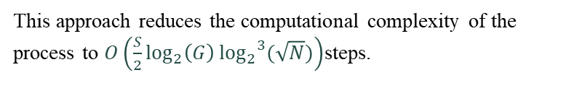
Quantum Initialization
01
Complexity
Complexity
This approach reduces the computational complexity of the process to $O\left({\frac{S}{2}log}_{2}\left(G\right){\log_{2}}^{3}{(\sqrt{N})}\right)$steps.
02
Quantum Selection
03
Complexity
04

Slide 21
7
Conclusion & Future Work

Slide 22
Conclusion & future work
Our research aimed to minimize power consumption in MIMO networks using a novel quantum genetic algorithm.
Refining the UQGA with advanced quantum-inspired methods and hybrid algorithms enhances power consumption minimization in MIMO networks
By considering practical constraints, channel dynamics, and deployment challenges, we can comprehensively assess its effectiveness in real-world operational environments.

Slide 23
Difference between grover’s algorithm & uqga
Grover Algorithm finds a specific entry in the Data Base that we already know
Unconstrained Quantum Genetic Algorithm finds the entry that we don’t know which is the extreme value
Grovers Algorithm can be run on the existing quantum computer, but the Database size is very low
The UQGA, can find the extreme values in a very large database

Slide 24
THANK YOU

